Slide 1
Let’s build advanced pipeline!

Slide 2
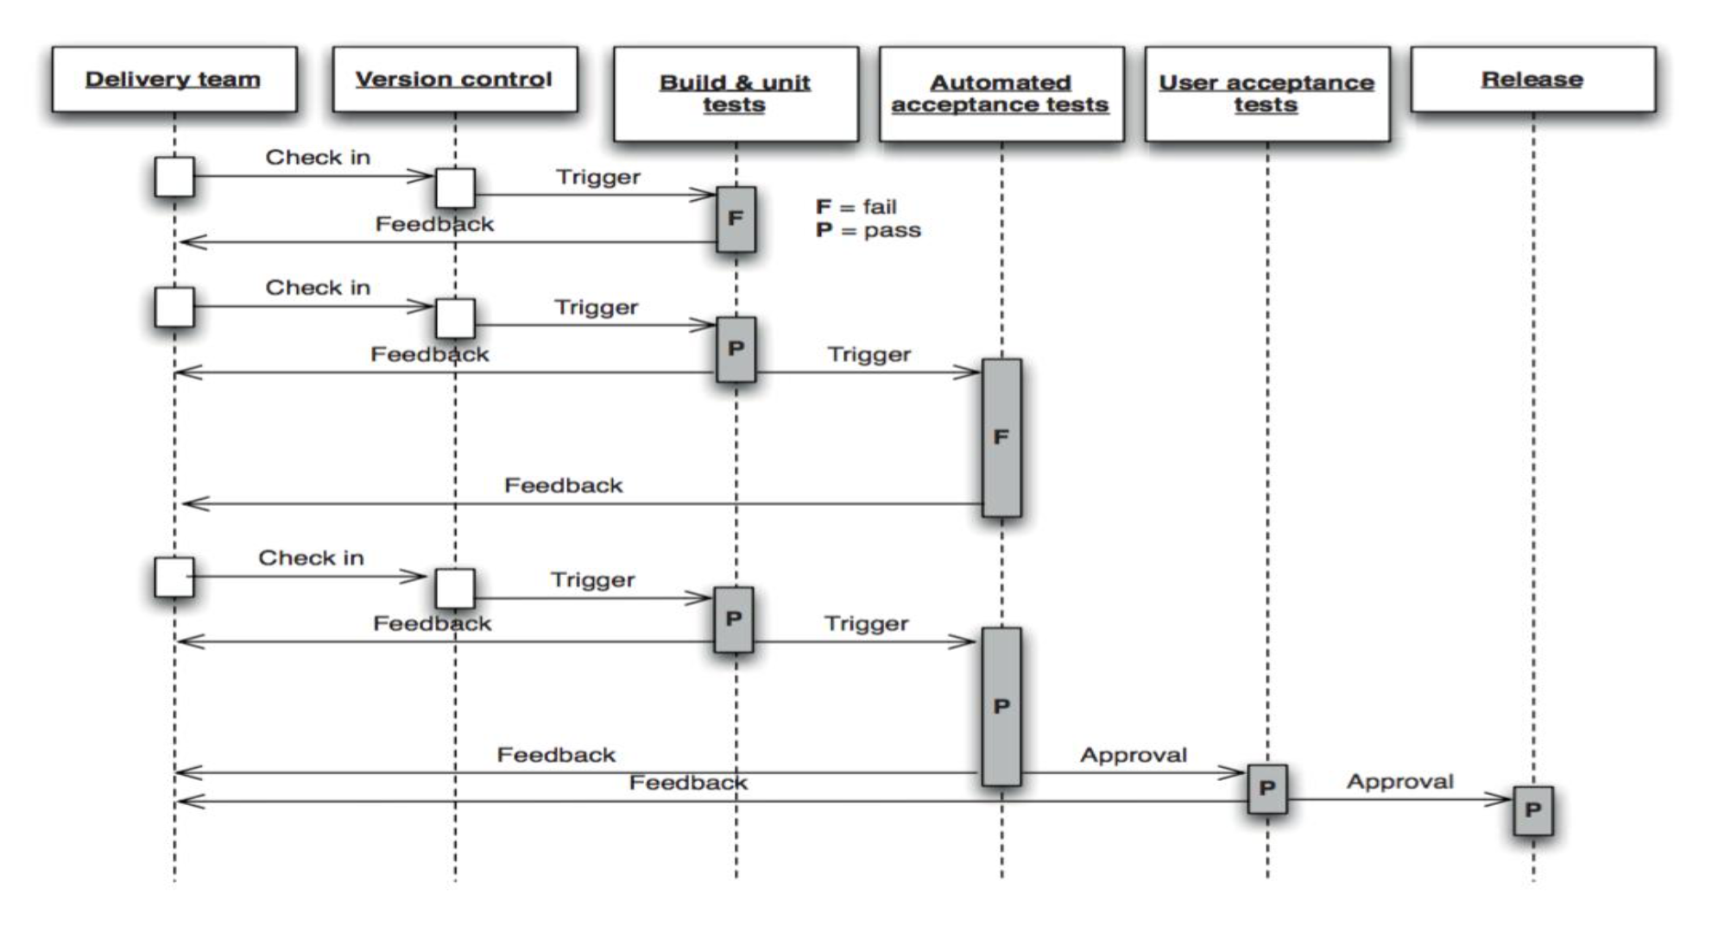

Slide 4
Build pipeline by connecting existing jobs

